Slide 1
LI-FI (LIGHT FIDELITY)
Course Title: Wireless and Mobile Communication
Course Code: ICT-4202
Supervised By:
Md. Nazrul Islam
Associate Professor
Dept. of ICT, MBSTU
Presented By:
Atiqur Rahman Sajib
ID: IT-21040
Dept. of ICT, MBST

Slide 2
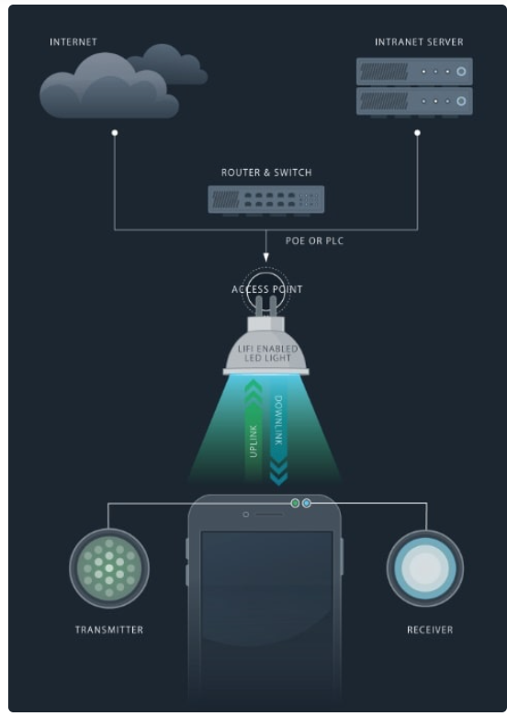
WHAT IS LI-FI?
Li-Fi uses LEDs to transmit data by encoding information in light intensity. It operates on a visible light spectrum vastly larger than radio spectrum. The data is encoded in the intensity of light and received by photodiodes. It enables high-speed communication using visible light spectrum, which is 10,000 times larger than the radio spectrum.

Slide 3

INTRODUCTION
Introduced by Prof. Harald Haas in 2011, Li-Fi offers a high-speed, secure alternative to Wi-Fi by modulating data into light waves beyond human eye perception. It allows bidirectional communication with minimal interference.

Slide 4
HISTORY OF LI-FI
First demonstrated in 2011 at University of Edinburgh, Li-Fi technology has rapidly evolved, now achieving transfer speeds up to 224 Gbps and expanding into real-world applications such as smart homes and medical fields.

Slide 5
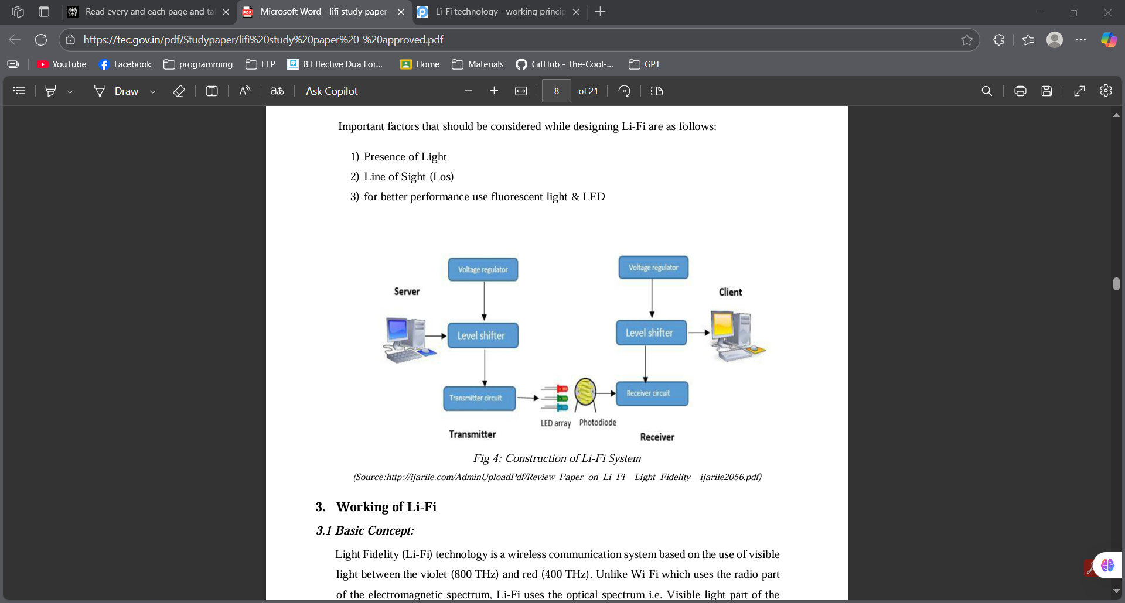
WORKING PRINCIPLE
Li-Fi sends data by modulating LED light intensity at extremely high speeds. Photodiodes on receiver devices detect these changes and convert them back to electrical data signals, invisible to the human eye due to fast flickering.

Slide 6
COMPONENTS OF LI-FI SYSTEM
LED Bulbs as transmitters
Photodiodes as receivers
Signal processing units for encoding and decoding
Internet connection for data feed

Slide 7
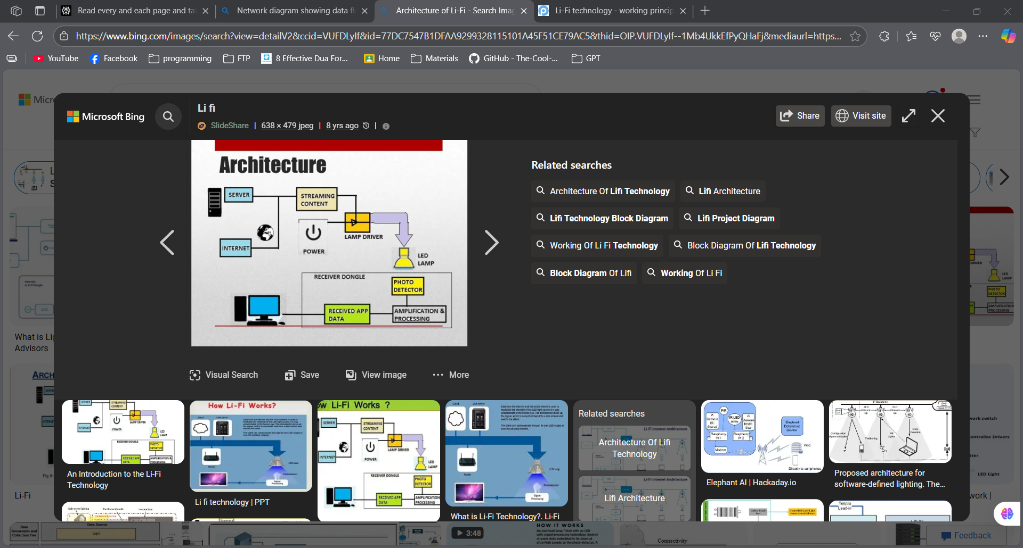
ARCHITECTURE OF LI-FI
Li-Fi architecture integrates LED lamps generating optical signals with photodiode receivers converting light to electrical data, connected through processing units to form a bidirectional, high-speed communication network.

Slide 8
LI-FI VS WI-FI
Feature | Li-Fi | Wi-Fi
Data Transfer Speed | Up to 10 Gbps (practical), up to 224 Gbps (lab) | Typically around 1 Gbps, up to ~10 Gbps with Wi-Fi 6/7
Range | Limited (~10 meters), requires line-of-sight | Covers larger areas, penetrates walls (~30+ meters)
Typical Use Cases | High-density environments, secure communication, specialized applications | General use in homes, offices, public places
Range | Limited (~10 meters), requires line-of-sight | Covers larger areas, penetrates walls (~30+ meters)
Security | More secure, confined to light area, signal cannot penetrate walls | Less secure, radio waves can penetrate walls, requires encryption

Slide 9
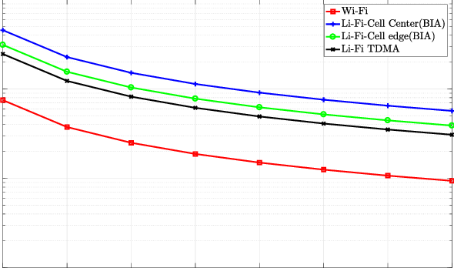
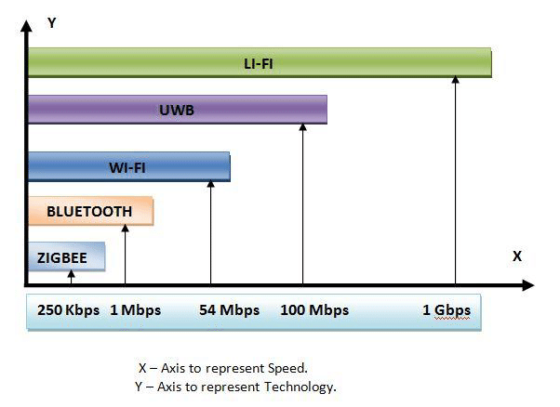
GRAPH: LI-FI SPEED VS WI-FI
Graph showing Li-Fi offering much higher data rates (10 Gbps) compared to Wi-Fi (1 Gbps).

Slide 10
ADVANTAGES OF LI-FI
Extremely High Speed
Enhanced Security (confined light limits eavesdropping)
No Electromagnetic Interference (safe for hospitals, aircraft)
Energy Efficient (uses existing LED lights)
Vast Bandwidth (significantly broader spectrum)

Slide 11
LIMITATIONS OF LI-FI
Requires Line-of-Sight connection
Vulnerable to ambient light interference (e.g., sunlight)
Limited operational range (confined to room or light area)
Infrastructure upgrades needed to widespread adoption
Limited mobility compared to Wi-Fi

Slide 12
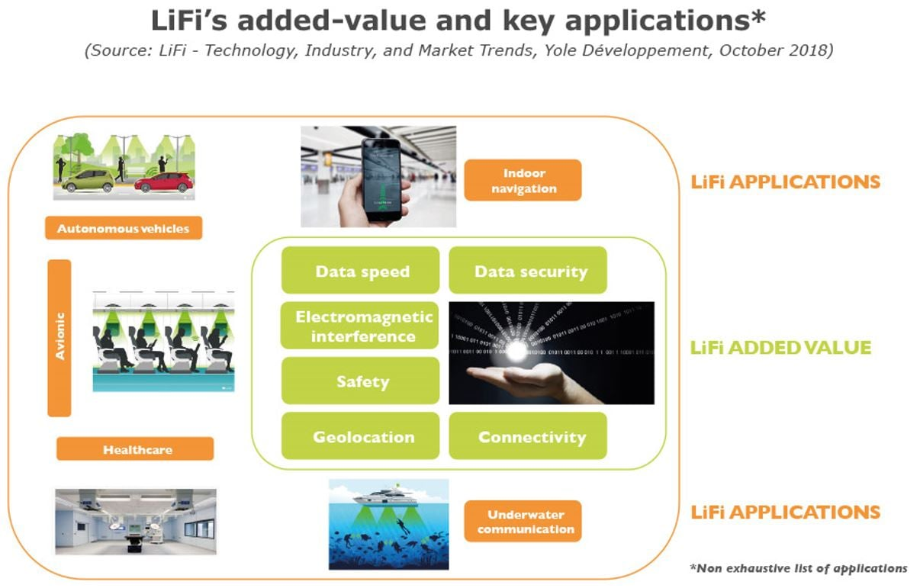
APPLICATIONS OF LI-FI
Smart homes and offices.
Underwater communication.
Aircraft cabins.
Hospitals and medical devices.
Industrial automation.
Street lighting and IoT devices.

Slide 13
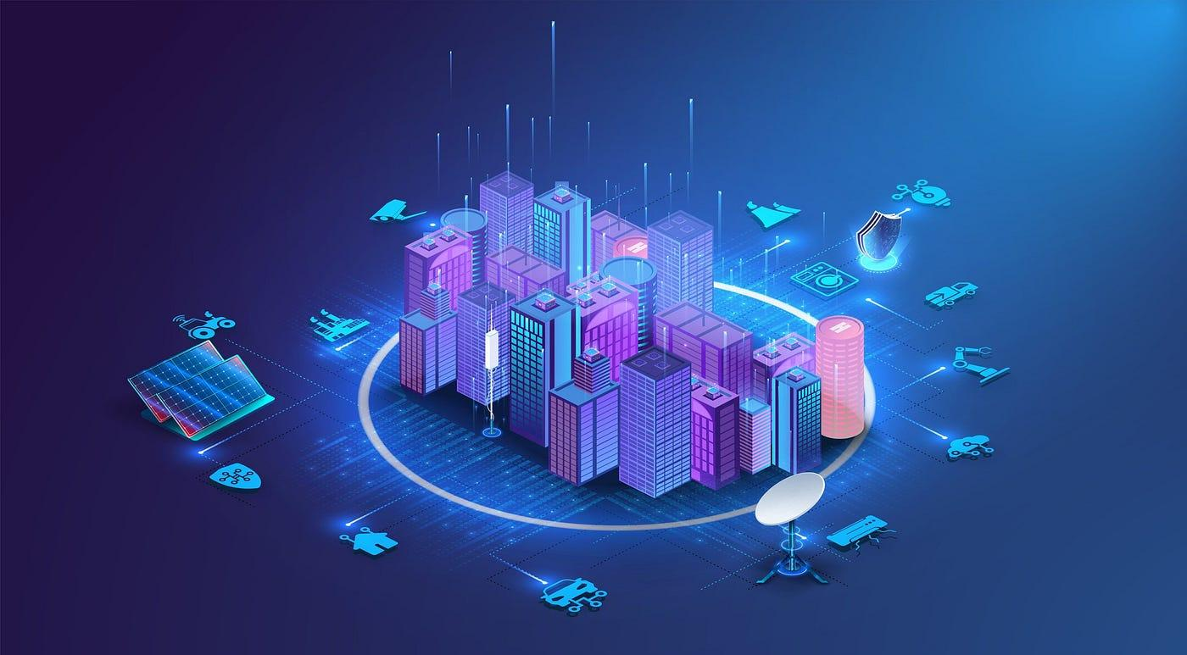

LI-FI IN SMART CITIES
Li-Fi supports smart city infrastructure through seamless streetlight connectivity, efficient traffic management, secure public networks, and scalable IoT deployments.

Slide 14
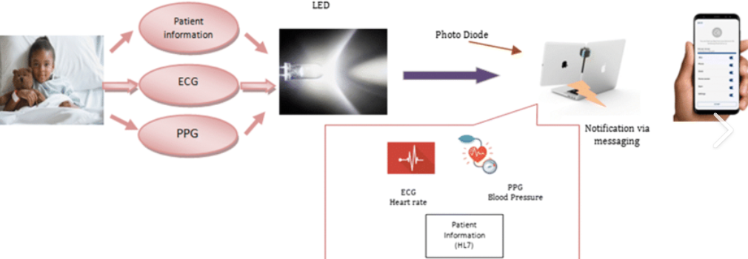
LI-FI IN HEALTHCARE
Li-Fi ensures ultra-secure, high-speed wireless communication in medical environments free from electromagnetic interference, supporting real-time patient monitoring, diagnostics, and healthcare data transmission.

Slide 15
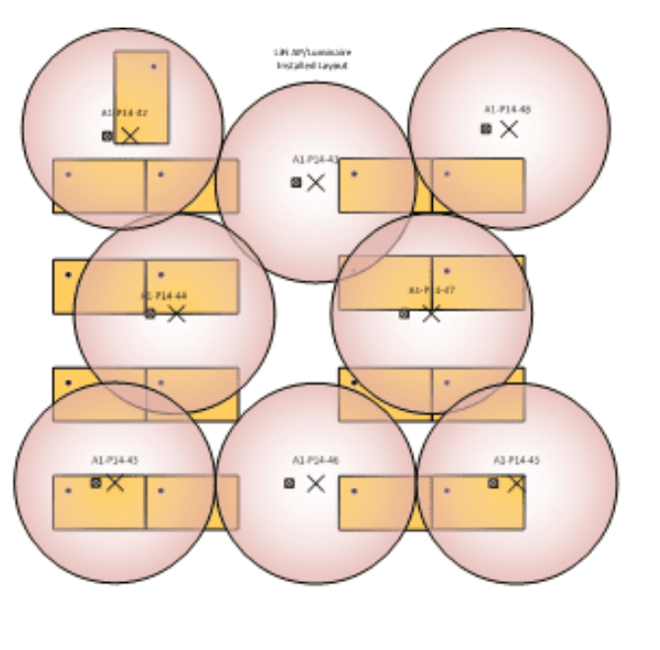
LI-FI IN EDUCATION
Classrooms benefit from Li-Fi’s fast, reliable internet delivered through LED lighting, enabling enhanced digital learning experiences without network congestion or radiation concerns.

Slide 16
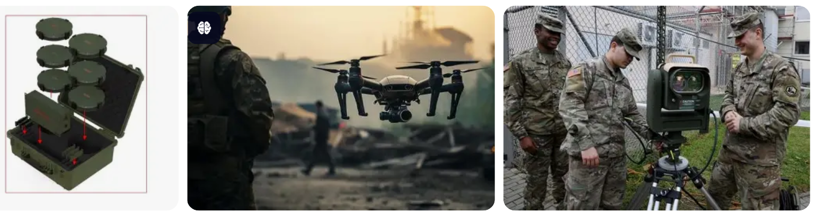
LI-FI IN DEFENSE AND AVIATION
Li-Fi provides secure, interference-free communication for military bases and onboard aircraft where radio transmissions are restricted or pose security concerns.

Slide 17
PERFORMANCE METRICS
Data Rate: up to 10 Gbps (lab)
Range: up to 10 meters indoors
Wavelength: 380–780 nm (visible light)
Power Consumption: Low
Security: High – confined to illumination area

Slide 18
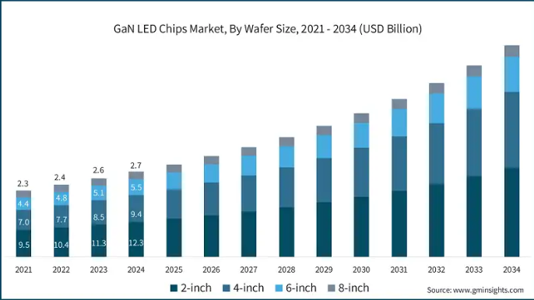
MARKET GROWTH OF LI-FI
The Li-Fi market is expected to grow exponentially in coming years.
According to market research, Li-Fi could reach $10 billion by 2030.

Slide 19
CONCLUSION
Li-Fi offers revolutionary high-speed, secure, and eco-friendly wireless technology with broad applications. Future developments aim to integrate Li-Fi with IoT, increase mobility, and expand global infrastructure for seamless connectivity.

Slide 20
THANK YOU!

